Slide 1


Exploration of SARS-CoV2
Data Analytics Bootcamp Capstone Project

Slide 2




STUDENT TEAM
Bill Remy
Phoenix, AZ
Celeste Moreno-Campoy
Phoenix, AZ
Samuel Guerette
Phoenix, AZ
Joy Arah
Phoenix, AZ
Notes:
Need to add Bills and Joys picture

Slide 3
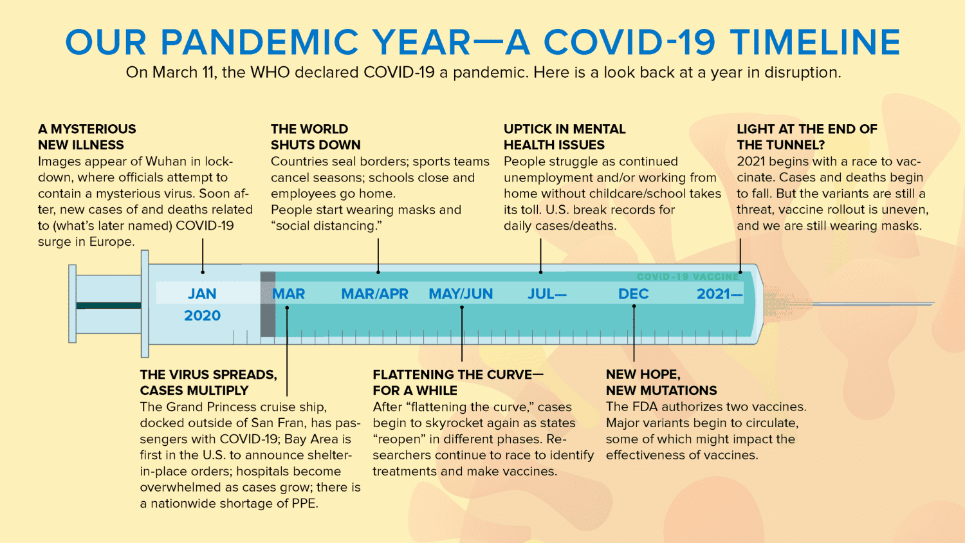
SARS-CoV2 National Impact
Figure 1
Total US cases : 91.6 M (CDC, 2022)
Total US deaths : 1.03 M (CDC, 2022)
Novel variants : Alpha, Beta, Delta, Omicron
Socio-economic downturn:
Food security
Public health
Employment and labour sectors
Education
Healthcare systems
Mental health , etc.
SARVS-CoV2 is the virus that causes the COVID-19 disease.
Note. Adapted from “Our Pandemic Year-A Covid-19 Timeline,” by Katella, K. K., & Szatiai, M. S, 2021, (https://www.yalemedicine.org/news/covid-timeline). In the public domain
Notes:
Reason why: COVID has drastically affected the world, threatening the lives of millions and wreaking havoc on social and economic players. Although COVID-19 has slowly become understood and there have been implementations for disease control, the threat of infectious diseases is still alarming. Throughout the primary years of COVID-19, it became evident that particular locations of the US were heavily affected while others were not. Thus, it is imperative to understand predicting factors and their relationships that may affect both case and death rates. By indicating high-priority areas in the US, one can reallocate resources to those locations and provide further assistance to combat spread. Additionally, this information can be transposed to future implications if another pandemic were to occur in the near future.

Slide 4
Chosen Source Data
US census 2021: https://www2.census.gov/programs-surveys/popest/datasets/2020-2021/counties/totals/
Displays overall population estimates, deaths, births, domestic migration, etc., by county.
Social Context for Understanding a Region: https://www.statsamerica.org/downloads/default.aspx
Gives social context data, such as as measurements of hopefulness, employment rate, conscientiousness, etc. by county data.
Social Vulnerability Index (SVI): https://www.atsdr.cdc.gov/placeandhealth/svi/
Provides estimates of poverty, unemployment, those above 65, disability, etc. by county.
Case Time Series Data - Johns Hopkins University: https://github.com/govex/COVID-19
Displays cumulative cases from 01/01/2020 - 10/03/2021 by US county.
Death Time Series Data - Johns Hopkins University: https://github.com/govex/COVID-19
Displays cumulative deaths from 01/01/2020 - 10/03/2021 by US county.
County Presidential Election Returns 2000-2020: https://electionlab.mit.edu/data-
Provides party affiliation from election returns at a county level.
County Hospital Data: https://hifld-geoplatform.opendata.arcgis.com/datasets/geoplatform::hospitals/about
Gives insight to total number of beds available in hospitals within the county level.

Slide 5
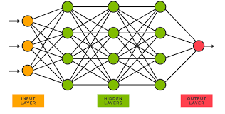
Chosen Technologies
Coding Language: Python
Visualization: Tableau and Jupyter Notebook (Pandas)
Database: AWS, Postgres
Machine Learning: Neural Network
However, also utilized decision trees and regression models during the machine learning process
Why Neural Network?
Contains the ability to learn by themselves and produce the output that is not limited to the input provided to them.
Even if a neuron is not responding or a piece of information is missing, the network can detect the fault and still produce the output.
They can perform multiple tasks in parallel without affecting the system performance.
Figure 2. Neural Network. Adapted from “What is a Neural Network?” by TIBCO, 2022, (https://www.tibco.com/reference-center/what-is-a-neural-networ). In the public domain
** Will be expanded upon in next segment**
Notes:
*Current model is still tied between neural network or random forest regression* Final decision will be solidified within the next week

Slide 6
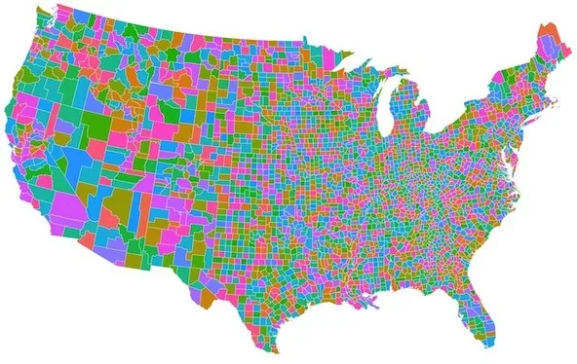
Investigation of COVID-19 Goal
Question to be Answered
Which counties are within the top 10% of worst case rates?
Which counties are within the top 10% of the worst death rates?
Which features in the dataset have the highest contribution towards case and death rates?
Our Goal
Utilize county population demographics, vulnerability data, death/case series rates, election data, hospital data, and social context information in order to predict low performing counties over the primary year of COVID-19 (March 2020 - March 2021).
Predict priority high risk (top 10%) counties for reallocation of resources.
Predict case and death COVID-19 rates at county level.
Notes:
County Picture: Stock photo and does not require reference by APA standards

Slide 7
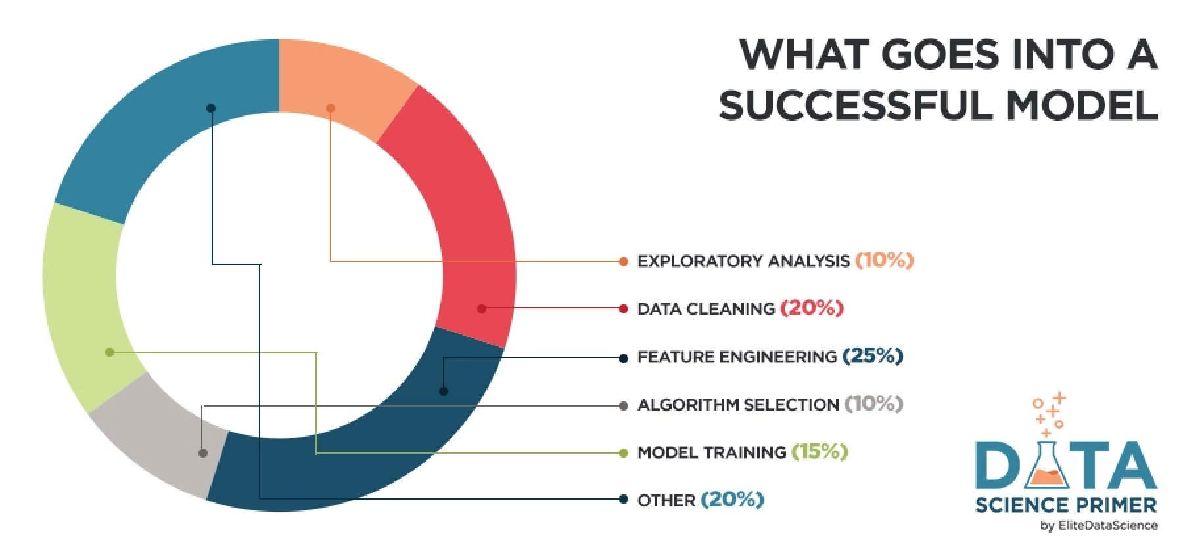
Phases of COVID-19 Model
Data Exploration
Detect missing values & outliers
Uncover initial patterns & characteristics
Create visualizations
Data Analysis
Cleaning
Summarization
Model planning
Determine inputs/outputs
Explore multiple models
Determine feature importance
Modeling Building
Establish best ML model
Communicate Results
Optimize Model
Figure 3. Machine Learning Process. Adapted by “Feature Engineering for Machine Learning” by Elite Data Science, 2022, July 14,( https://elitedatascience.com/feature-engineering). In the public domain

Slide 8
Phase 1 : Data Exploration
Initially used Pandas to merge and clean data, which will later be implemented in SQL during the development of an AWS database.
Evaluated and removed any NaN values and corrupted values
Cleaned county data to ensure only county information (FIPS) was listed in FIPS columns in all datasets.
Determined which columns were applicable to be joined in final merged dataset.
Utilized Tableau and Jupyter Notebook to create visual analytics and search for valuable insights of all seven datasets and final merged dataset. This included overall patterns and characteristics of the datasets.
Implemented statistical methods to view hidden relationships and any logical groupings.
Correlation matrix, regressions, clustering, decision trees and so forth
If a particular dataset did not present adequate information, it was necessary to drop inadequate datasets and explore more suitable options.

Slide 9
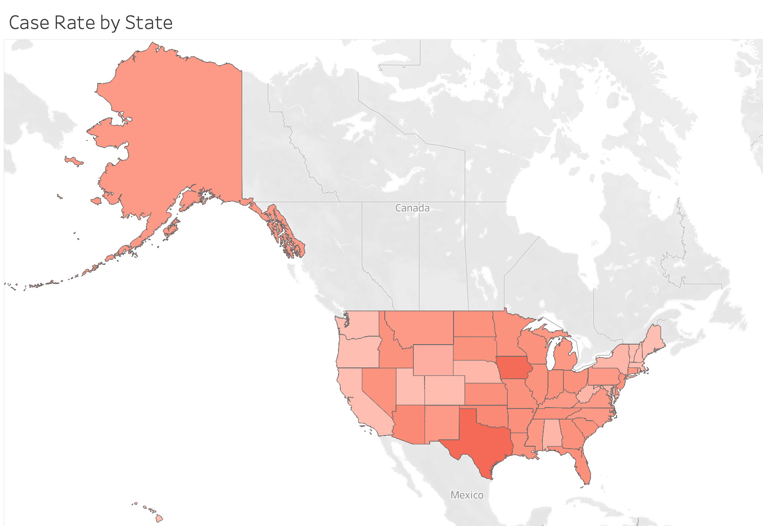
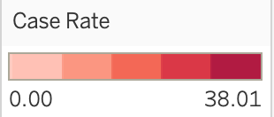
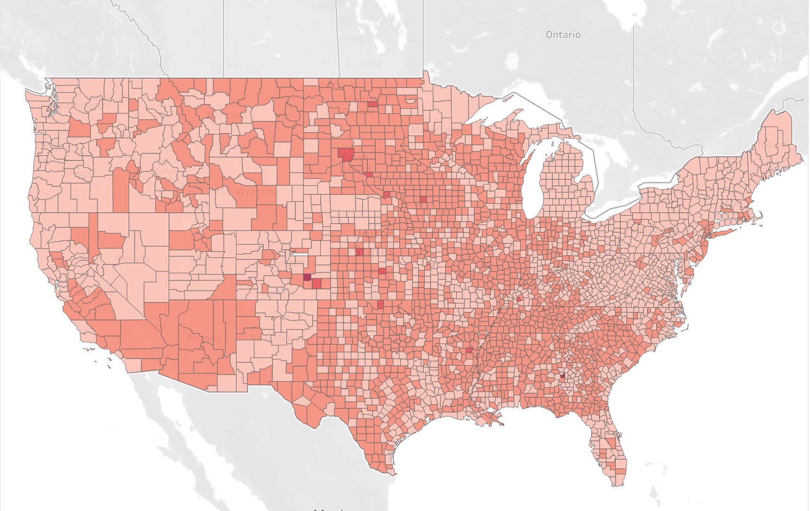
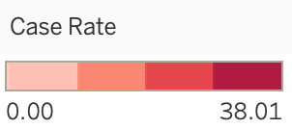
Case Rate by State
Case Rate by County

Slide 10
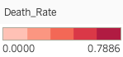
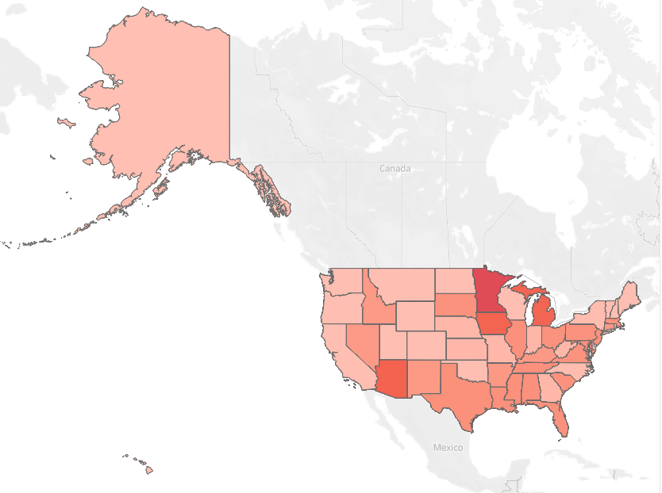
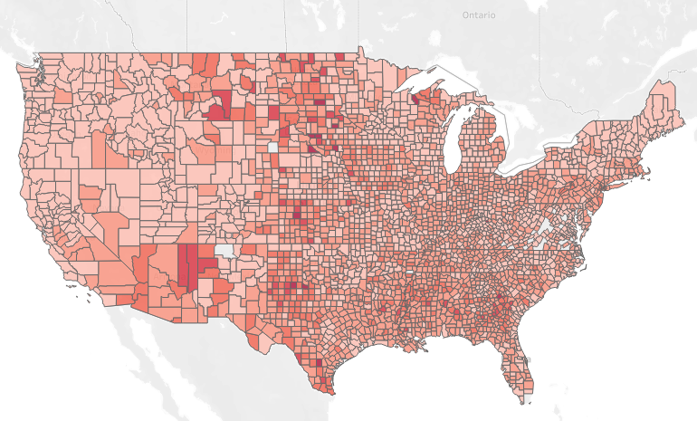
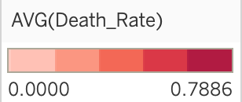
Death Rate by State
Death Rate by County
*Need to fix counties in death rate*

Slide 11
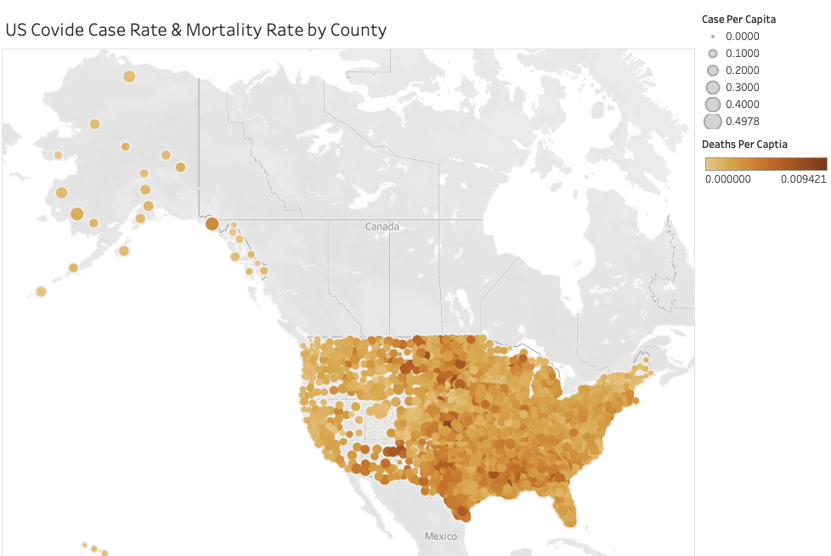
Cases & Deaths Per Capita

Slide 12
Phase 2 : Analysis
Set up and connected to AWS database
Ensured the merged dataset is optimally prepared for analysis
Included only relevant columns in accordance to our goal
Determined outputs = (top 10% case rates and deaths)
Transformed the output to a binary output
1 : within the top 10%, 0 : below the top 10%
Implemented decision trees, regression, and clustering methods to determine feature relationships and importance
Applied columns of critical feature importance to Neural Network
Evaluated opportunities of optimization
Adding hidden layers
Changing functions
Increasing epochs
Addressing possible overfitting
Neural Network Code: https://github.com/sdguerrette/capstone_project
**During presentation will explain Analysis and NN by going through the code in Github**

Slide 13
Results of Analysis *Segment 3*

Slide 14
Recommendations for Future Analysis *Segment 3*

Slide 15
Looking Back *Segment 3*
Implement a Gantt Chart to delegate responsibilities and roles per week
Include major deliverables along with necessary sub-tasks to complete weekly deliverables
Beneficial in seeing progress and high priority project segments
Start with the simplest ML model and increase complexity each week

Slide 16
Covid Dashboard Overview
Project Dashboard - Tableau Public
Scope of Project Study - March 2020 - September 2021
Project Overview
Problem Statement/ Hypothesis
Baseline data
Map of Covid Case/Mortality Rate by County
Interactive maps/graphs - Filter by geography/case/mortality data
Project Data
Data Sources
Data Exploration
Data Synthesis
Various Visuals of Case/Mortality/Social Vulnerability
Interactive/Filter by State/County
Machine Learning Model(s)
Neural Network
Random Forest
Regression
Static Visuals
Machine Learning Results
Model Accuracies
Model Predictions
Static Visuals
Project Summary & Conclusions
Key Findings
Model usability
Next iteration of modeling

Slide 17
References
CDC. (2020, March 28). COVID Data Tracker. Centers for Disease Control and Prevention. Retrieved August 2022, from https://covid.cdc.gov/covid-data-tracker/#datatracker-home

